Slide 1

SMART INDIA HACKATHON 2026
TITLE PAGE
Problem Statement ID – SIH26171
Problem Statement Title- On-Device Visual Perception for Light-weight Browser Agents
Theme- Space Technology (ISRO)
PS Category- Software
Team ID- SIH_CU_143
Team Name (Registered on portal): Orvyn

Slide 2
IDEA TITLE
Orvyn
OUR SOLUTION
SentryLens combines local visual or DOM sanitization with an agent action loop and local placeholder resolution.
In the tools reviewed by our team, we found no single workflow combining all three capabilities
Current agent platforms document important privacy and prompt-injection limitations. SentryLens addresses the problem at the device boundary through local perception and redaction
Documented Privacy Boundaries in Current Agent Platforms
Claude Computer Use
Anthropic advises isolating computer-use environments from sensitive data
OpenAI Agent
Screenshots are part of agent operation and remain associated with the agent conversation
Comet
Independent security testing demonstrated prompt-injection paths to private Gmail data
Dia
Operating policies note that relevant page content may be routinely transmitted to third-party AI providers during active user interactions.
Cloud browser agents
Lacks pre-transmission redaction, sending raw data directly to the server.
Maintains a full, active agent action loop.
Does not perform on-device value resolution.
Local redaction tools
Performs redaction prior to transmission, but strictly focused on text.
Lacks an integrated agent action loop.
Does not perform on-device value resolution.
What make SentryLens different?
Redacts data on-device before transmission, covering both visual pixels and DOM elements.
Integrates a full agent action loop seamlessly with redaction.
Resolves placeholder values locally on the device.
User Screen & Visual Capture
Traditional agents send the complete screenshot to a remote AI system.
This may expose sensitive information present on the screen.
Local Privacy Layer
SentryLens first detects sensitive PII, faces, passwords and visual information locally.
Sensitive content is redacted and replaced with placeholders before transmission.
Remote AI Agent
The AI receives only the sanitised representation and understands the webpage.
It generates the required agent action such as click, type or navigation.
Local Resolution & Action
SentryLens resolves protected placeholders to their real values locally.
The browser executes the action while raw sensitive values remain on-device.
Agent workflows use screenshots as part of visual interaction; privacy controls do not perform device-side PII redaction before the screenshot reaches the agent

Slide 3
TECHNICAL APPROACH
Orvyn
SentryLens — Privacy-Preserving On-Device Browser Agent
BROWSER EXTENSION — LOCAL(Trusted)
WXT / MV3 · TypeScript · React · Offscreen Document
Transformers.js v4
ONNX Runtime Web
WebGPU → WASM fallback
LAYER 1 — ON-DEVICE PERCEPTION
DOM Walk
YOLOs-Tiny
Tesseract.js
Screen Understanding
GLiNER
MediaPipe
SmolVLM-256M
LAYER 2 — TRUSTED REDACTION ENGINE
DOM +Vision + OCR+ NER +
Face Signals
Sanitised PNG + JSON Manifest (Category · BBox · Value Length · Risk · Task Task Necessary)
Signal Fusion
Risk Classification
Validators (Regex · Luhn · Verhoeff · PAN · IFSC)
Canvas Masking
TRUST BOUNDARY
Only sanitised data crosses
Layer 3- REMOTE AI
REPEAT UNTIL TASK COMPLETED
Qwen2.5-VL-32B
- OpenAI-Compatible API
- Ollama / vLLM
LOCAL PLACEHOLDER RESOLUTION
BROWSER ACTION EXECUTION (Execute Locally)
PERCEIVE AGAIN
Layer1 /2
Node / Express Thin Proxy
AgentAction (Click · Type · Scroll)
VALIDATION & SECURITY
Zod Contracts | Network Firewall | Unit Tests | Headless E2E | No-Leak Verification

Slide 4
Orvyn
FEASIBILITY AND VIABILITY
From on-device perception → privacy-preserving agent execution
WHY IT IS FEASIBLE
Built with proven open-source technologies
Prototype Demonstration
KEY CHALLENGES
OUR SOLUTION
1. WebGPU – GPU-accelerated local perception
2. WASM – CPU fallback when WebGPU is unavailable
3. On-Device ML – OCR, PII, NER, Face Detection, Vision
4. Browser Native – Chrome / Edge 113+
5. No Client GPU Server – Perception runs locally
6. Working Prototype – Login → Dashboard → Open Report → Done
WebGPU Unavailable
OCR / Missed PII
Over-Masking
MV3 Worker Eviction
Connectivity Loss
WebGPU unavailable
Automatic WASM fallback
OCR / missed PII
Fuzzy matching + checksums + manual review
Over-masking
MV3 worker eviction
Connectivity Loss
Risk score + task_necessary flag
Persistent offscreen document
Three-tier degradation
Primary
WebGPU available → GPU local perception
Secondary
WebGPU unavailable → WASM fallback
Offline
Server disconnected → On-device execution
Fail-Safe
Model not cached → DOM-only redaction
PERCEIVE
DETECT
REDACT
SEND
ACT
EXECUTE
WHY OUR IDEA IS VIABLE?
No Vendor Lock-in
Horizontally Scalable
Offline-Capable
Fail-Safe Privacy
Performance:
~1–2 s / step perception
~2–3 s on integrated-GPU laptops

Slide 5
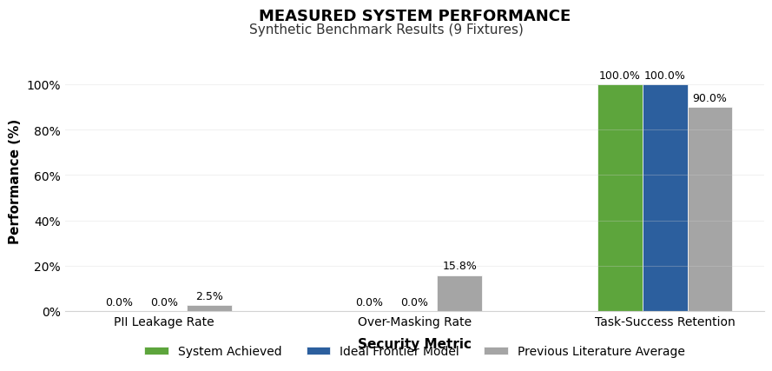
IMPACT AND BENEFITS
Orvyn
1. SECURITY & SOVEREIGNTY
0% PII leakage in tested fixtures
Faces & passwords remain on-device
EXIF removed from exported images
2. TASK UTILITY
100% task-necessity accuracy in the tested case
Redaction preserves the information needed by the AI agent
Real values are restored locally
3. ECONOMIC BENEFIT
Enables use of open-weight AI models
Reduces need for private frontier-model infrastructure
Drop-in protection for existing browser workflows
4. ADOPTION
Enables AI agents in privacy-sensitive environments
Relevant to ISRO, government, banking, healthcare & defence
Supports offline / low-connectivity operation after model caching

Slide 6
RESEARCH AND REFERENCES
Orvyn
Privacy & GUI Agents
GUIGuard — https://arxiv.org/abs/2601.18842
Available but Invisible — https://arxiv.org/abs/2602.10139
DualTAP + PrivScreen — https://arxiv.org/abs/2511.13248
MaskClaw — https://arxiv.org/abs/2605.28646
Vision & UI Understanding
Qwen2.5-VL — https://arxiv.org/abs/2502.13923
OmniParser V2 — Microsoft Research
SmolVLM — https://arxiv.org/abs/2504.05299
Implementation
Transformers.js + WebGPU
Chrome Offscreen API
MediaPipe Face Detector
Luhn / Verhoeff Validators
Prototype
SentryLens — https://github.com/Aaryan658/sentrylens

